Slide 1
Sampling
Santosh Chhatkuli
Lecturer Amrit Science Campus

Slide 2
Terminology used in sampling
Population: A population may be defined as any identifiable and well-specified group of individuals or objects that interest us theoretically. It is the collection of all the individuals or objects researcher are studying and about which the researcher wishes to draw conclusions or make decisions.
Sample: It is a finite part of a population whose properties are studied to get the information about the whole. A sample is any number of persons or objects selected to represent the population according to some rule and plan.
Sampling: It is a process of drawing (randomly or non randomly) some units of population as representatives of the entire population.

Slide 3
Target Population: It refers to the entire group of individuals or entities that you want to study or about which you want to draw conclusions or to make generalizations about. This is the population that your research aims to understand, and ideally, your findings should be applicable to this group.
In most cases, the target population is theoretical or conceptual and may not be fully accessible for practical reasons.
Example: If a study is about the sleep habits of all university students in the Nepal, then all university students in the Nepal form the target population.
Accessible Population: The accessible population , also known as the study population, is the subset of the target population that is actually available or reachable for the study. Due to practical constraints such as time, cost, resources, and logistical limitations, researchers often cannot access the entire target population.
Example: If the researcher can only survey students from two universities due to resource limitations, then students from these universities form the accessible population.

Slide 4

Population size: It is the no. of units in finite population. It is denoted by ‘N’
Sample size: It is the no. of units in a sample. It is denoted by ‘n’
Sampling fraction: It is the ratio of sample size to the population size. It is denoted by ‘f’.
Sampling frame: Any list of all the sampling units in the population is called sampling frame.
Sampling error: It is the difference between the values emerging from sample and those emerging from the population on some phenomenon. It is the function of amount of variability in measuring factor of interest and sample size. It is associated with the type of the sample design chosen for sampling.
Non sampling error: Non-sampling error is the error attributable to all sources other than sampling error, including non-response, bad communication with interviewees, measurement error, etc. It can be classified into two groups: Random error and Systematic error.
Sampling fraction ($f)=\frac{Sample size (n)}{Population size (N)}$

Slide 5
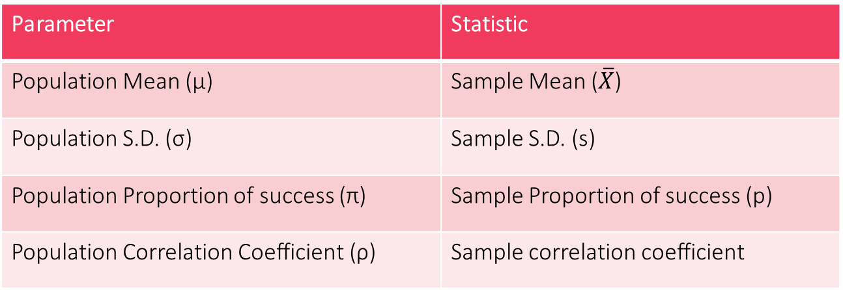
Parameter: A parameter is summary measure that is computed to describe a characteristics of entire population. Greek letters are used to symbolize population information.
Statistic: A statistic is a summary measure that is computed to describe a characteristics from only a sample of the population. Roman letters are used to symbolize sample information.
Sample representativeness: It is the degree to which sample is similar to the target population in terms of key characteristics such as gender (male, female), place (rural, urban) etc.
Sample external validity: It the extent to which one can infer characteristics of a sample to the target population.
Parameter | Statistic
Population Mean (µ) | Sample Mean ($\overline{X}$)
Population S.D. (σ) | Sample S.D. (s)
Population Proportion of success (π) | Sample Proportion of success (p)
Population Correlation Coefficient (ρ) | Sample correlation coefficient

Slide 6
Reasons for studying sample (why we choose to sample ?)
The reasons are:
Sample allows us to draw conclusion about a whole by examining only a part.
Studying samples is easier than studying the whole population.
A study of sample is less expensive than studying an entire population.
Samples can be studied more quickly than populations.
Depending upon the size and accessibility of the parent population, it may be impossible and impractical to make measurements on all its members. So, we resort to sample.
Study of sample helps to collect quality data by focusing on a smaller group and increase the accuracy of the investigation.

Slide 7
Objectives of sampling (what we hope to learn from the sample ?)
To describe or explain population characteristics or phenomenon.
To explain the relationship between variables
To explore the research topics and gaining a deep understanding of the research topic.
To estimate the population parameters such as mean, standard deviation, proportion, correlation coefficients etc.
To test the hypothesis about the population from which the sample or samples are drawn or relationship between variables.

Slide 8
Major challenges in sampling
To draw representative sample.
To choose appropriate sample size so that it sufficiently entails the population characteristics.
To choose appropriate sampling technique.

Slide 9
Advantages of sampling over complete census
The main advantages of sampling technique over the complete enumeration may be outlined as follows:
Less time: There is considerable saving in time and labor if sample is studied rather than whole population.
Reduced cost: The costs on sampling is much lower than that on census.
Greater accuracy: The quality of a study is often better with sampling than with a census.
No alternatives: In some studies we are bound to study sample.
Studying large population: For example, trees in jungle we have no alternative than to study sample of trees.
Destructive test: If the quality of an item can be determine only by destroying the item in the process of testing we resort to sample. For example testing the quality of milk, testing the life of an electric bulb etc.
Studying hypothetical population: For example, in coin tossing experiment where the process may continue indefinitely sampling method is the only method of estimating the parameters of the universe.

Slide 10
Major research methods
The most popular research methods are:
Survey research method
Experimental research method
Observational research method
Survey is that research method in which same set of questions or items are asked to respondents in a structured interview format and answer are recorded and analysed using statistics. It is the most common research tool, especially used by companies that produce IT products, software to know about customer like/dislikes, their opinions, improvements of quality of services and products.

Slide 11
Methods of data collection in survey
The types of survey based on instruments:
Face-to-face interview using interview schedule
Questionnaire technique
Online survey or electronic survey
Telephone interview
The first two methods are also known as paper and pencil survey method.

Slide 12
Census Survey
A census is a complete enumeration of all the elements of population. It is much larger in scope and bigger exercise in nature and procedures than a sample survey. It takes lots of time to complete because information needs to be gathered about every unit in the population. Census surveys are also expensive because large numbers of people are involved in collecting the information.
Sample Survey
A sample survey is a survey conducted by taking a portion of the population of a specific location and results are then analyzed and extended to the population as a whole. Sample surveys are conducted by companies to arrive at conclusions that help in improving the products or services of a company. They are also conducted by government, research institutions and individuals on various disciplines such as health, education, technology, social issues etc.

Slide 13
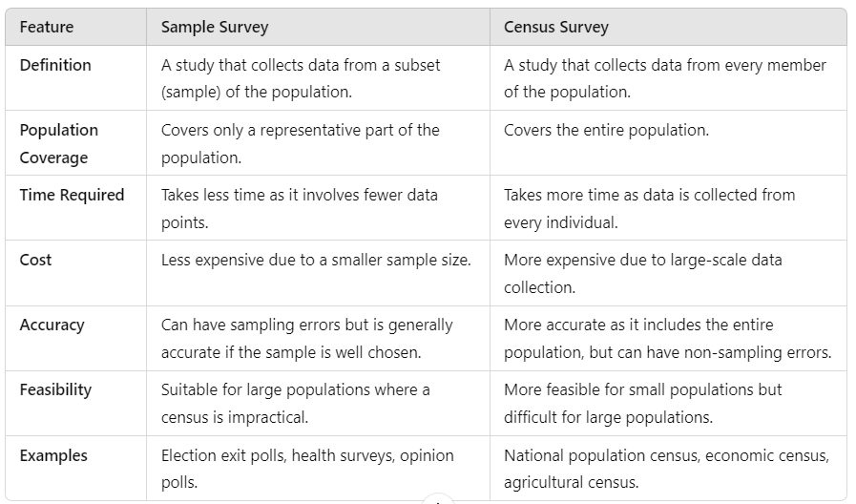

Slide 14
Steps in sampling process
The steps are:
Step 1: Define the target population i.e. the population to be covered.
Step 2: Construct the sampling frame.
Step 3: Specify the sampling method for selecting units from the frame.
Step 4: Determine the sample size.
Step 5: Plan procedures for selecting sampling units (Sampling plan).
Step 6: Select actual sampling units and enumerate them.
Step 7: Test the reliability of the sample.

Slide 15
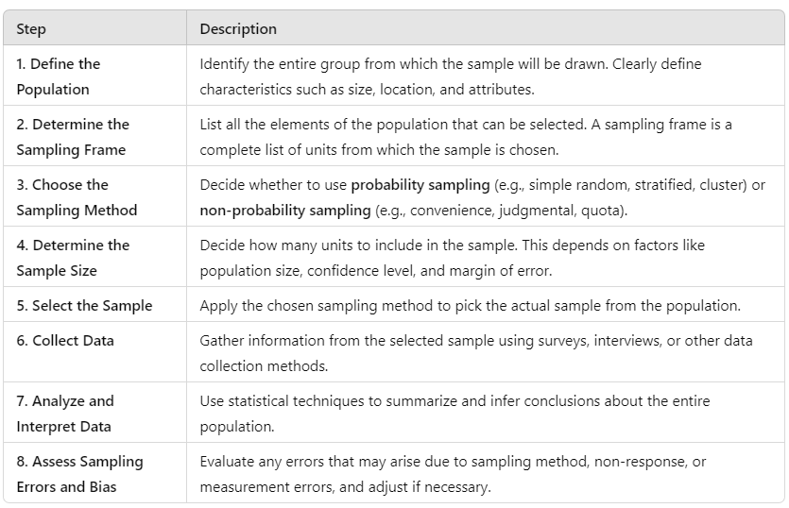

Slide 16
Sampling Design
A sample design is a definite plan for obtaining a sample from a given population. Researcher must select a sample design which should be reliable and appropriate for his/her study. The choice of proper sample design is done before data collection.
Sample design are basically two types
Probability sampling (Random sampling)
Non-probability sampling (Non-random sampling)

Slide 17
Some examples of random sampling design:
Simple random sampling
Stratified random sampling
Systematic random sampling
Cluster sampling
Multi-stage Sampling
Probability proportion to size sampling
Some examples of non-random sampling design:
Convenient sampling
Availability sampling
Quota sampling
Snowball sampling or referral sampling
Volunteer sampling

Slide 18
Difference between random and non-random sampling design
The main difference between random and non-random sampling is that random sampling involve random selection and non-random sampling doesn't.
In random sampling each member of the population has a non-zero probability of being selected which is known in advanced. The probability is unknown in case of non-random sampling.
Using random sampling we can generalize our findings to the population defined by the sampling frame. Using non-random sampling we can’t generalize our results i.e. we can’t make inferences about population characteristics.
Sampling error can be calculated under random sampling whereas calculation is not possible under non-random sampling.
Sampling frame is required for random sampling. Non-random method is used when sampling frame is not available.
Random samplings are used mostly in quantitative research whereas non-random samplings are used mostly in qualitative research.
Random sampling are relatively costlier than non-random sampling.

